Slide 1

AWS Lambda & Serverless Framework
By Carlos Cavalcante

Slide 2
Welcome
What will we see on this presentation?
What is Lambda
What is Serverless
How install them
Why should use them

Slide 3
What is aws Lambda?
AWS is a cloud provider
The cloud provide you servers and services that you can use on-demand and scale easily
Lambda are functions: No servers to manage
Short executions: Charged by time and when is trigged
Scaling automated
Integrated with whole AWS stack
Integrated with several languages

Slide 4
Creating lambda function without serverles
AWS console Lambda
Create function
Select configuration
A) Name
B) Runtime: Language to use to write the function

Slide 5
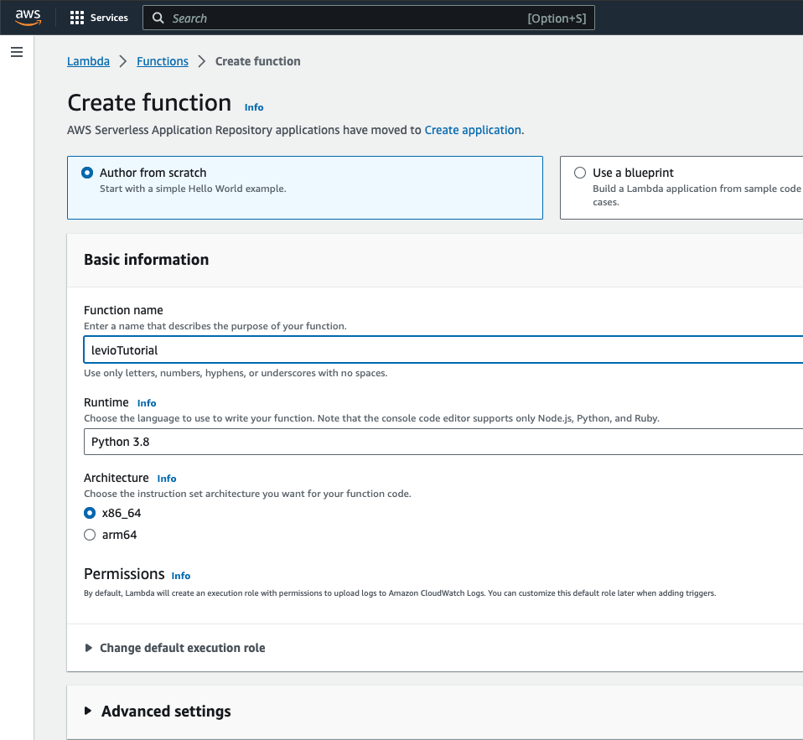

Slide 6
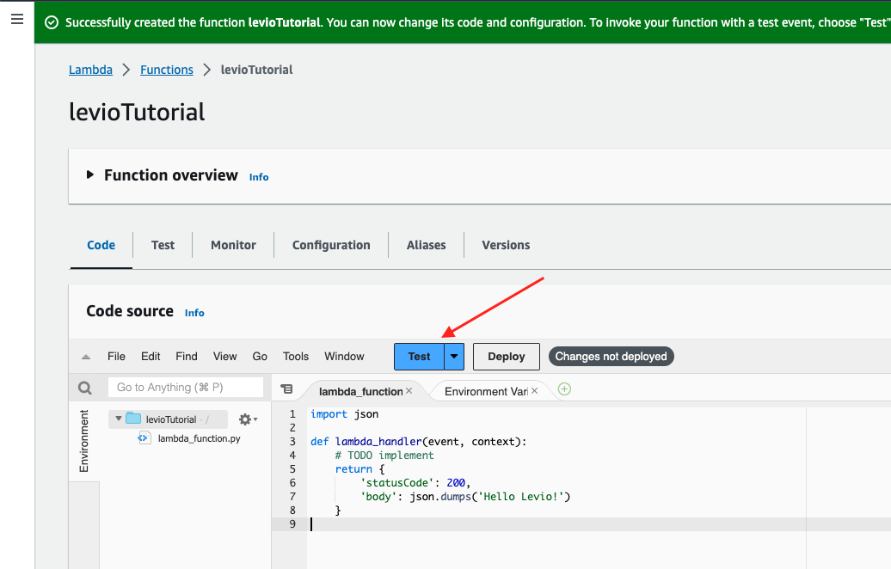

Slide 7
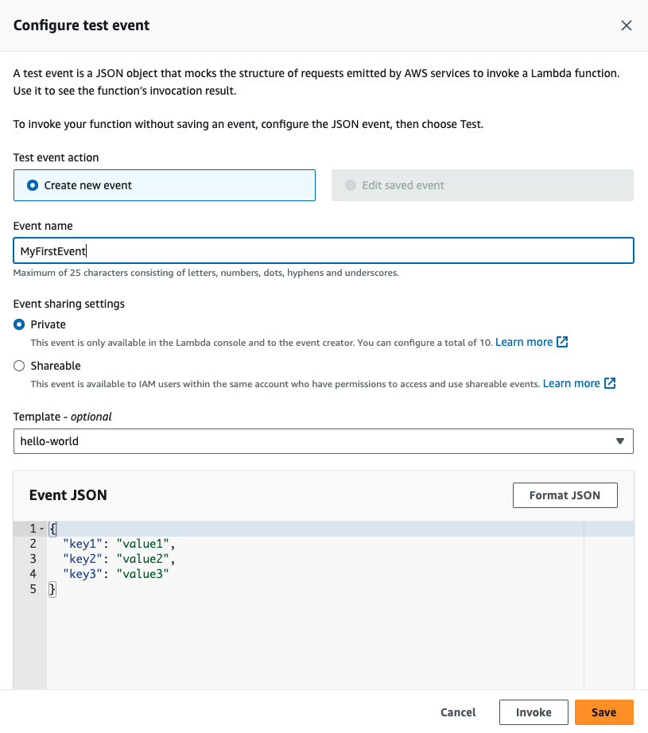

Slide 8
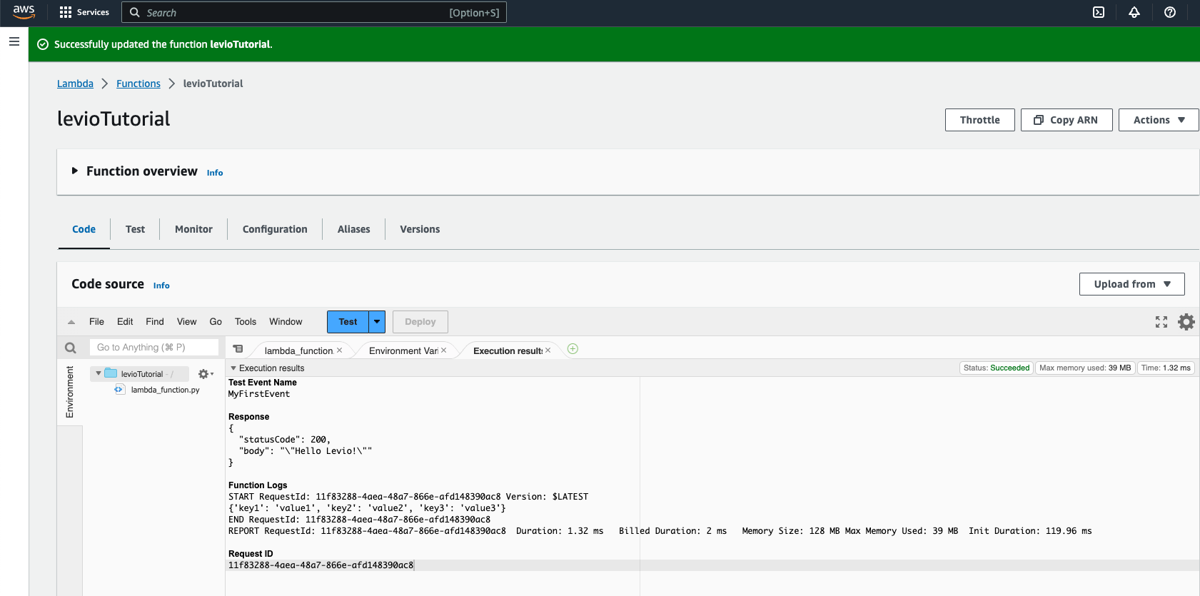

Slide 9
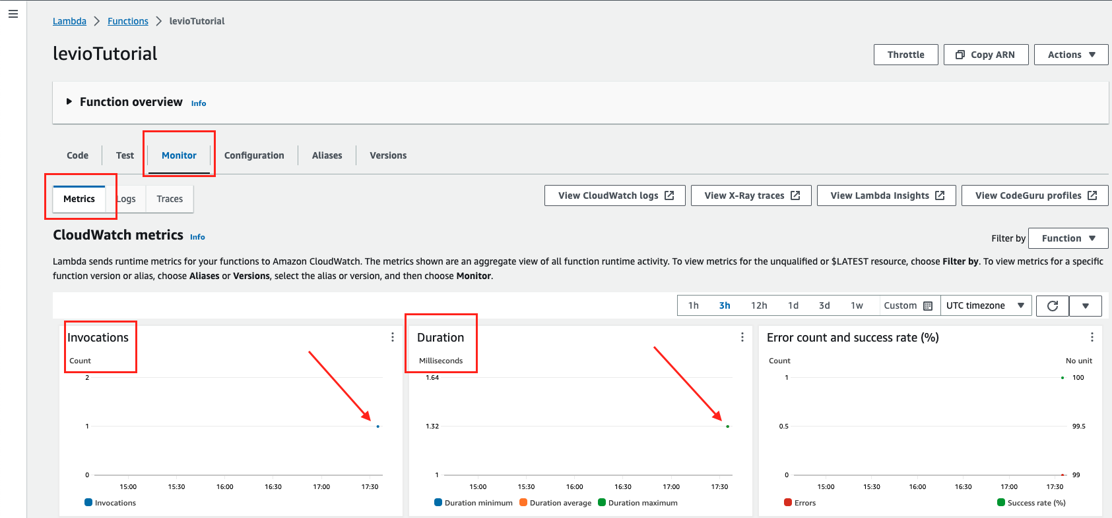
Remember that:
We pay by invocations and duration

Slide 10
Steps to create lambda + serverless
In AWS, create an user
Get the access key and secret key
GET Serverless connect to AWS

Slide 11
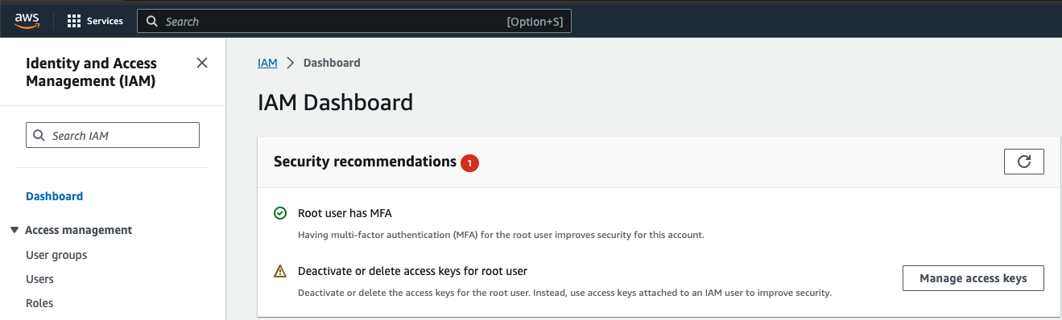
Add user in aws

Slide 12
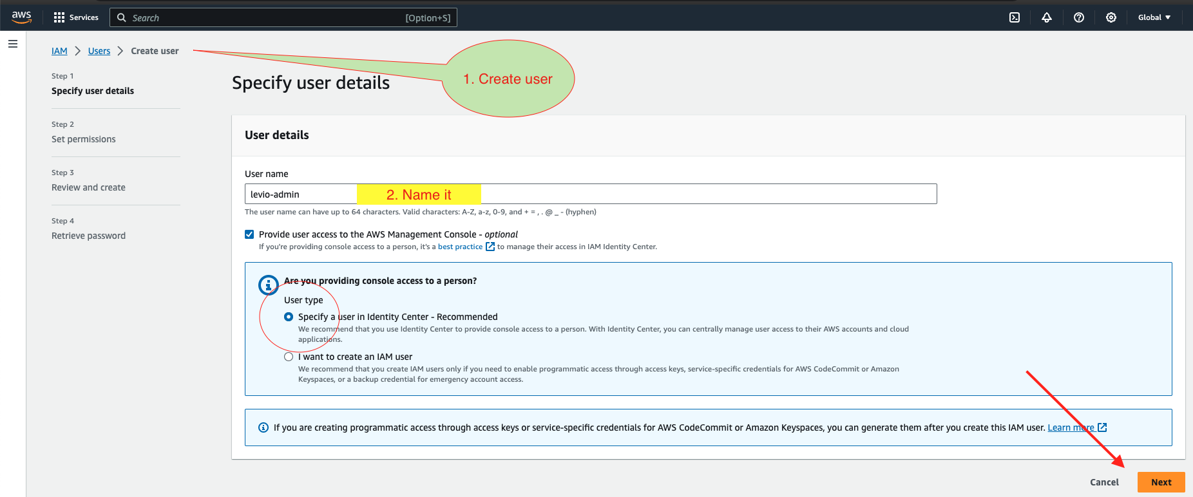
Create user in iam
IAM: Identifier Access Management – it is a global service

Slide 13

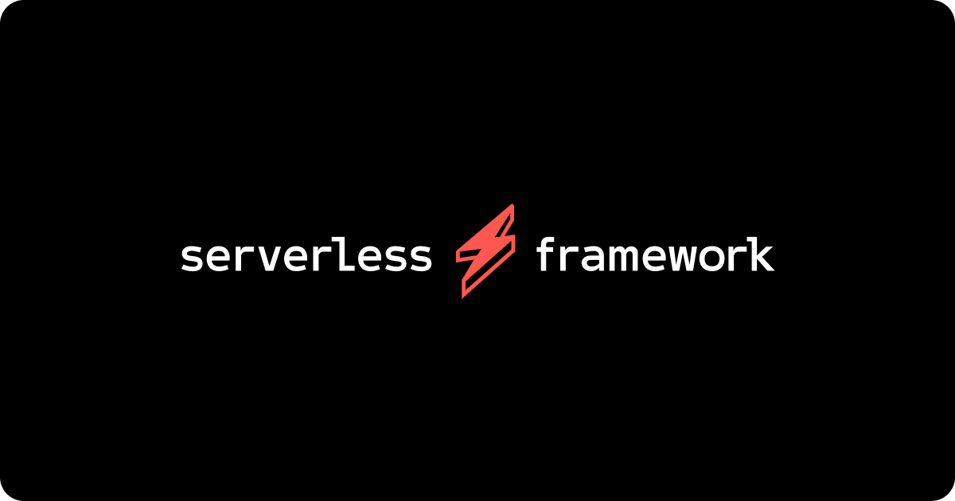
Serverless framework
It makes ease: creating, deploying, managing and debugging lambda functions
Install Node.js
Install Serverless
AWS cloudformation support

Slide 14
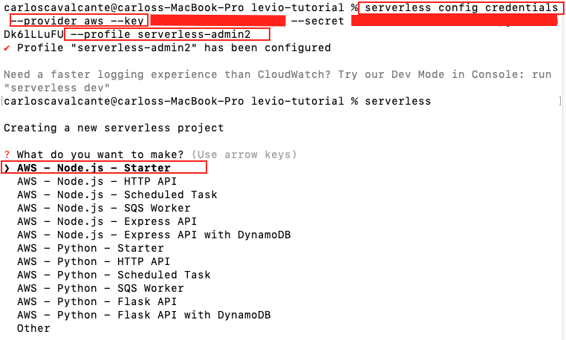
Install serverless

Slide 15
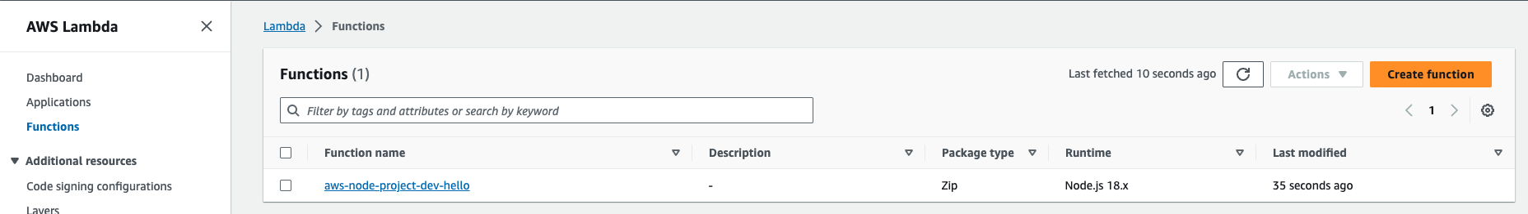
Aws lambda function has been created

Slide 16
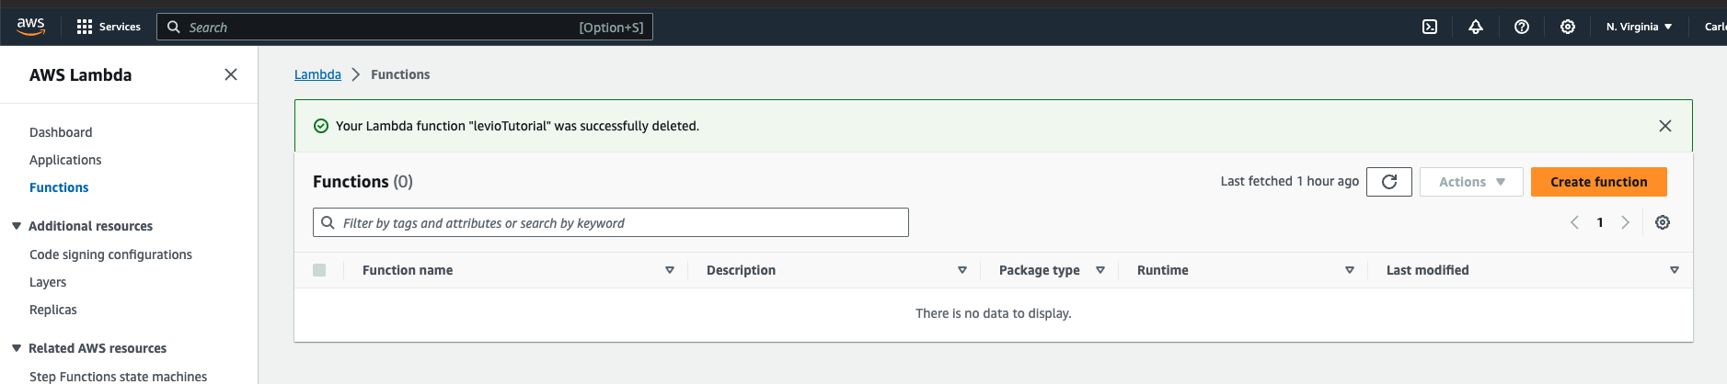
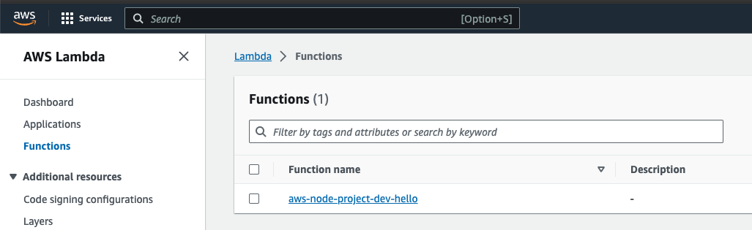
Function is created without push
Refresh >>>

Slide 17
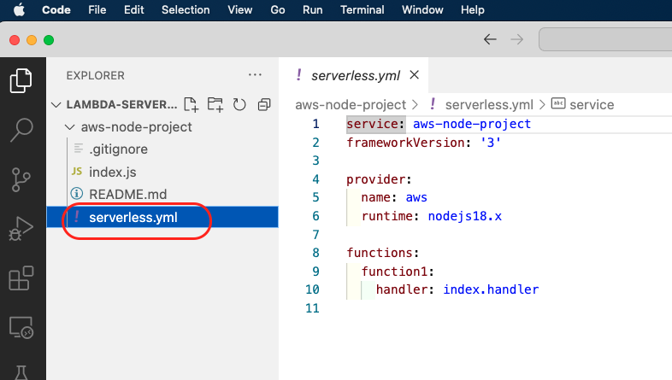
VS code

Slide 18
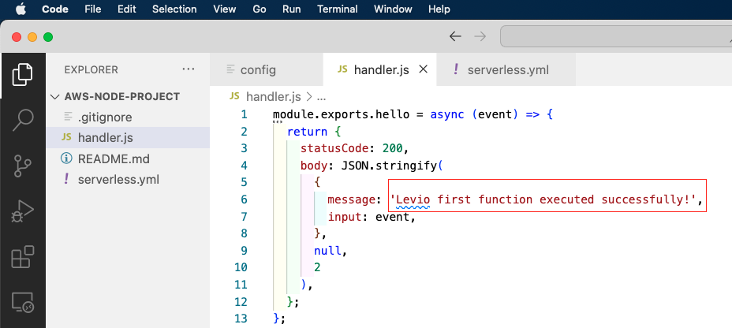
Introduce you Function hello

Slide 19
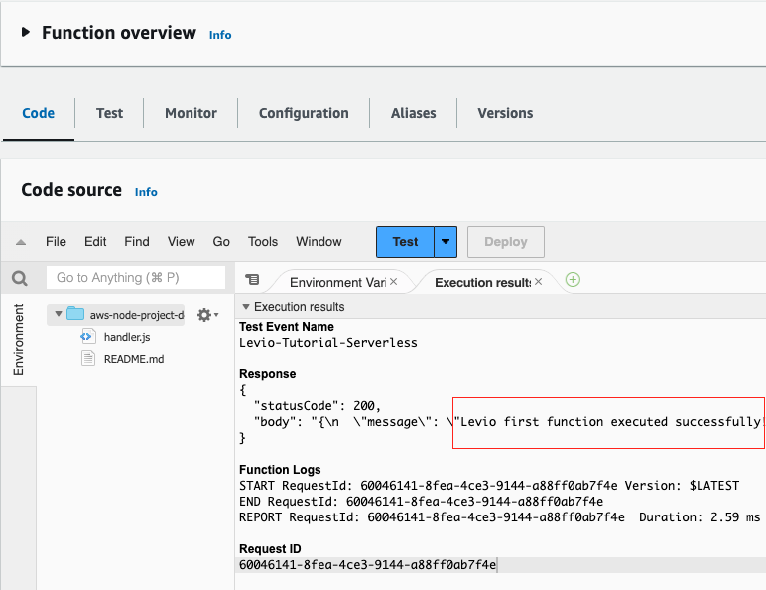
Modify function
sls deploy function –f function_name

Slide 20
Serverless framework
Advantages:
lower cost, scalability, and speed of development.
Very easy to create a function, when use a template
CLI: Few clicks and deploy in AWS without pushing code

Slide 21
setup
It must be installed: https://serverless.com/
Install Node.js: https://nodejs.org/en/download
Install Serverless: sudo npm i –g serverless
AWS
Serverless Provider: serverless config credentials --provider aws --key 123 --secret 123 --profile user_aws_name

Slide 22
Thanks
Questions?

